Slide 1
— Steps towards successful TBLA
14th July 2018
Denise Flipo and Liz Clark

Slide 2
Outline
Rationale
Procedure
Trial results
Challenges
The future
Outstanding questions
Question time

Slide 3
Definition
What is TBLA?
“The elicitation and evaluation of language use (across all modalities) for expressing and interpreting meaning, within a well-defined communicative context, for a clear purpose, towards a valued goal or outcome.” (Norris 2014)

Slide 4
Rationale: why TBLA?
authentic: assesses real world behaviours
aligns closely with classroom and workplace tasks
some scope for student autonomy
involves all 4 skills
no cheating possible!

Slide 5
Rationale: RMIT Training
course-reflective
positive washback
takes pressure from EOCs
formative

Slide 6
Procedure—pretrial
task choice
preparations
teacher input

Slide 7
Procedure—during trial
Task
‘Interview an expert’
interviewer, expert, 2 observers
Step 1 - task info, decide roles
Step 2 - brainstorm questions and ideas
Step 3 - interview, feedback
Step 4 - written reflection

Slide 8
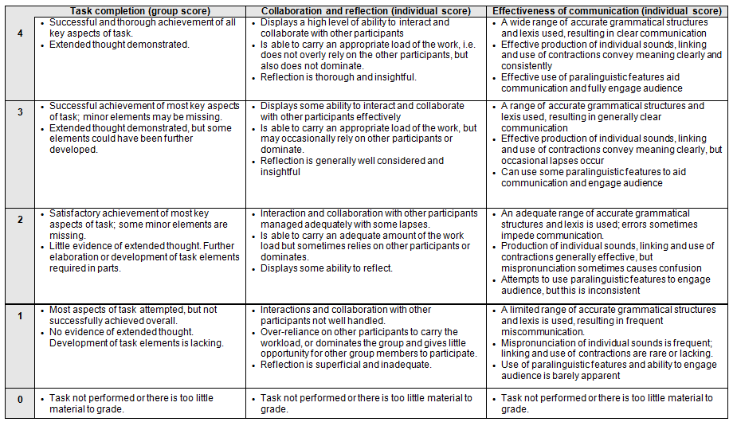
Rubric
Notes:
best fit
group score

Slide 9
Procedure—post trial
student feedback
teacher feedback
assessment team debrief

Slide 10
Post trial—positive responses
Students
control
enjoyment
course reflective
Teachers
authenticity
washback
worthwhile

Slide 11
Post trial—issues that emerged
Students
difficult to understand other students
too difficult (one student)
Teachers
difficult to monitor all SS fairly
role unevenness in level of challenge
felt the need to intervene at times

Slide 12
Challenges: fairness & reliability
subjective
uneven level of difficulty
difficult to monitor evenly
differing approach by teachers

Slide 13
Challenges: pushback
significant change
more active role for teachers
curriculum busy
concerns about fairness

Slide 14
Challenges: practicality
precise timing difficult
giving meaningful feedback
management role interferes with monitoring role

Slide 15
Future
teacher notes
teacher buy-in
utilise technology
low stakes
tolerance of ambiguity

Slide 16
Outstanding questions
pushback?
fairness?
freedom vs structure?

Slide 17
Questions?

Slide 18
References / Further reading
Norris, J M (2014) How do we assess task-based performance?, webinar, CALPER/LARC, Retrieved 4th June, 2018 <https://www.slideshare.net/larcevents/how-do-we-assess-taskbased-performance-with-dr-john-norris>
Van Gorp, K & Deygers, B (2014) ‘Task-Based Language Assessment’ in Kunnan, A J (ed.), The Companion to Language Assessment Volume II, Wiley Blackwell, UK, pp. 578-593

